Slide 1
Performance Comparison of Different Quadrature Methods for Double Integrals
Ryan Adoni
I pledge my honor that I have abided by the Stevens Honor System.

Slide 2
Goals
Demonstrate The Composite Trapezoidal, The Composite Simpson, and The Gaussian Quadrature Rules for double integrals and their adaptive variants
code these six methods in MATLAB
compare the different methods, display their outputs and results, and analyze the difference between their results

Slide 3
Findings
I implemented all six methods in MATLAB and prepared graphics to display how they all work
I found that the adaptive variants are generally better, which was expected since they can use the same number of points, but in a smarter way by distributing more points to areas with higher variation
The Gaussian Quadrature is really accurate and it caused some issue with my adaptive variant

Slide 4
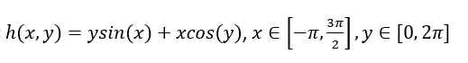
Findings Continued
Take the following example equation:

Slide 5
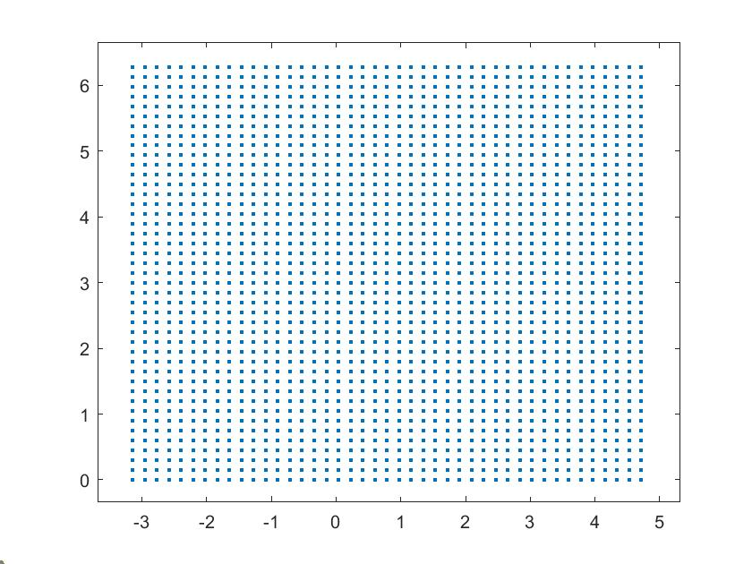
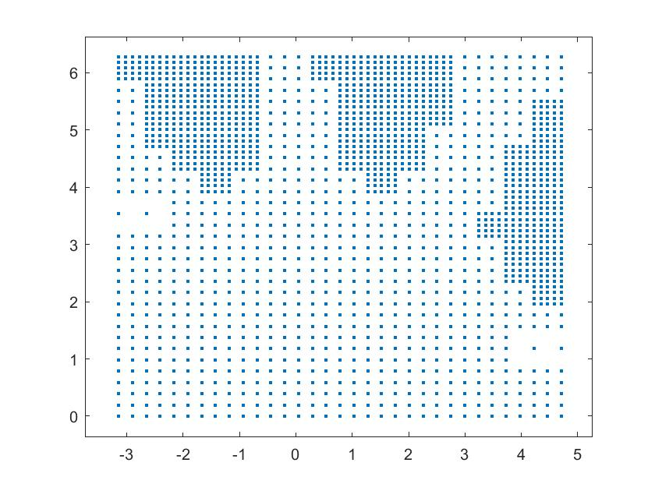
Findings Continued
Composite Trapezoidal Rule

Slide 6
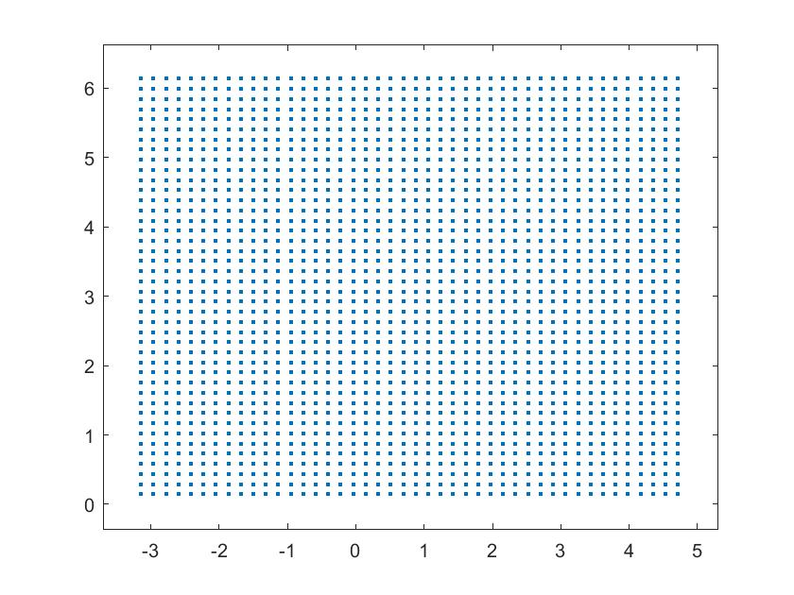
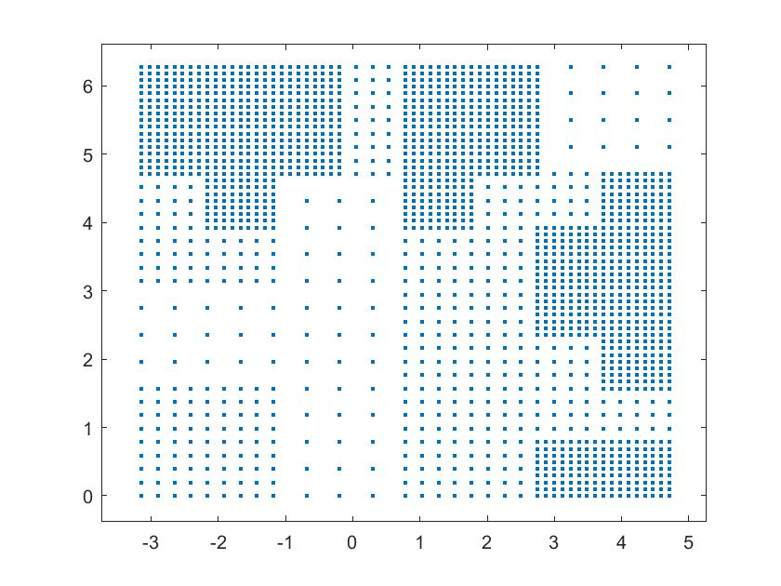
Findings Continued
Composite Simpson’s Rule

Slide 7
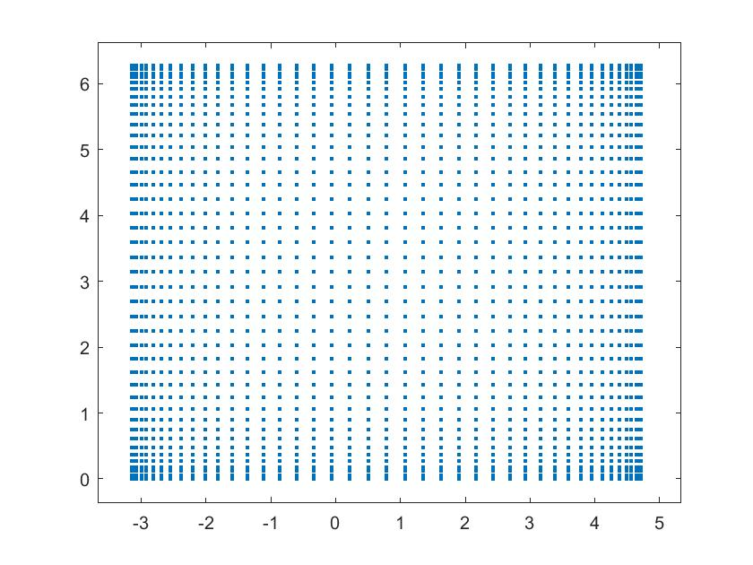
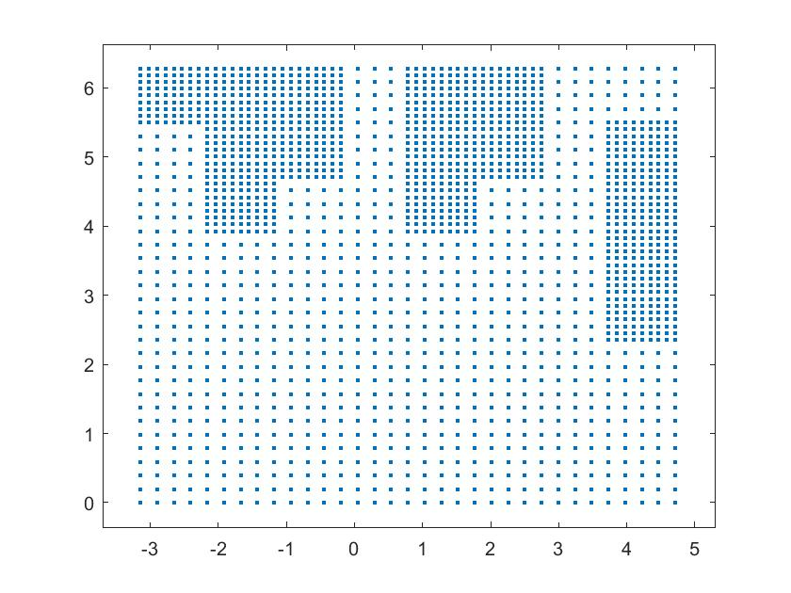
Findings Continued
Gaussian Quadrature

Slide 8
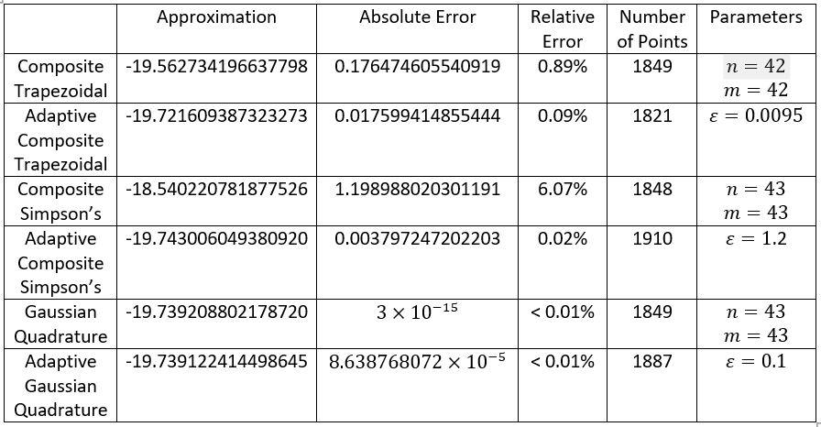
Notes:
Attempting to hold the number of points relatively constant by arbitrarily using
for the Adaptive Gaussian Quadrature and tuning the other parameter values for the other methods we get the above table.

Slide 9
Conclusions
The code implemented show the methods and their adaptive variants
The graphs above demonstrate the differences between the methods and how they sample points differently from functions
For The Gaussian Quadrature the non-adaptive version is slightly more accurate. It seems like a potential reason for this is because the fine approximation and coarse approximation are very close (their absolute difference is smaller than epsilon), but different enough that areas with variation are not explored as much as they could or should be.

Slide 10
References
Burden, Richard L., et al. Numerical Analysis. Brooks Cole, 2016.
Gander, W., Gautschi, W. Adaptive Quadrature—Revisited. BIT Numerical Mathematics 40, 84–101 (2000). https://doi.org/10.1023/A:1022318402393, https://www.researchgate.net/publication/226706221_Adaptive_Quadrature-Revisited

Slide 11
Thanks!
Questions?

